Slide 1
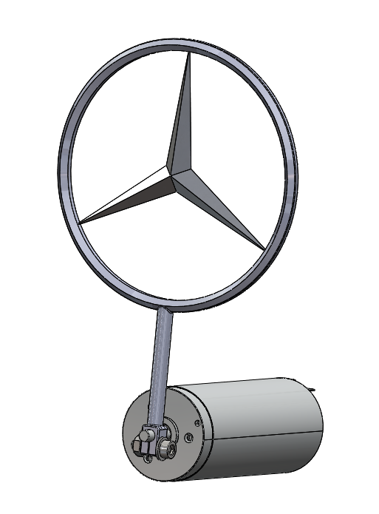
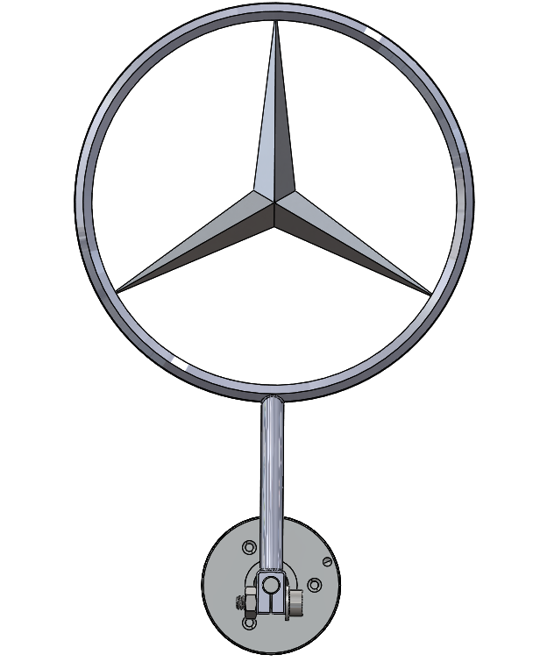
Notes:
Mercedes pendulum logo
DCX 16 L 16mm DC motor

Slide 2
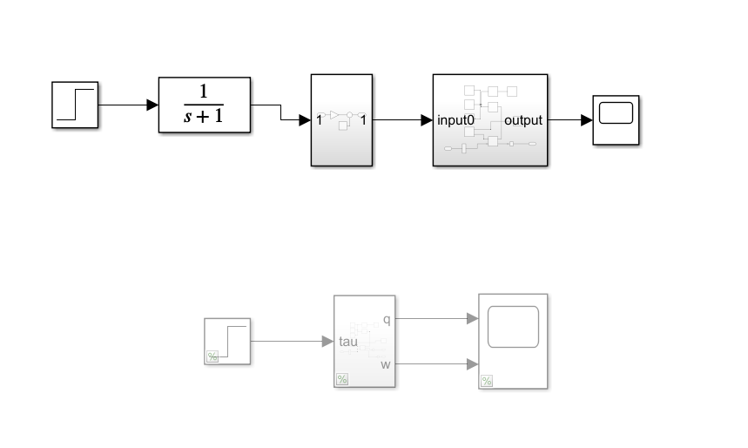
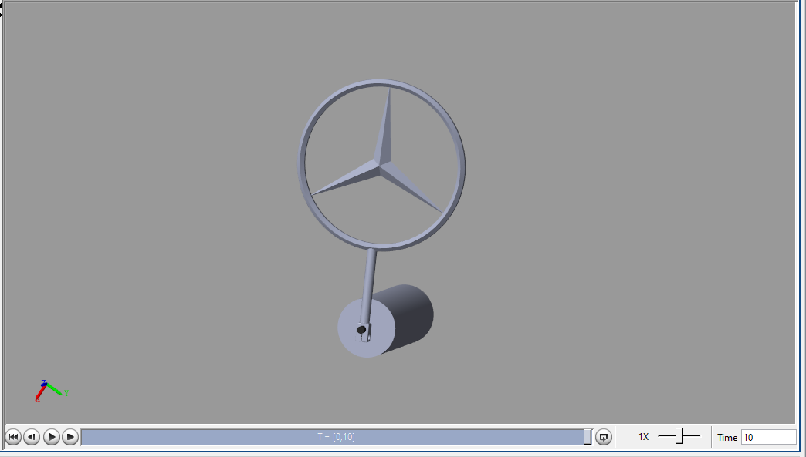
Notes:
Position and force control in simscape

Slide 3
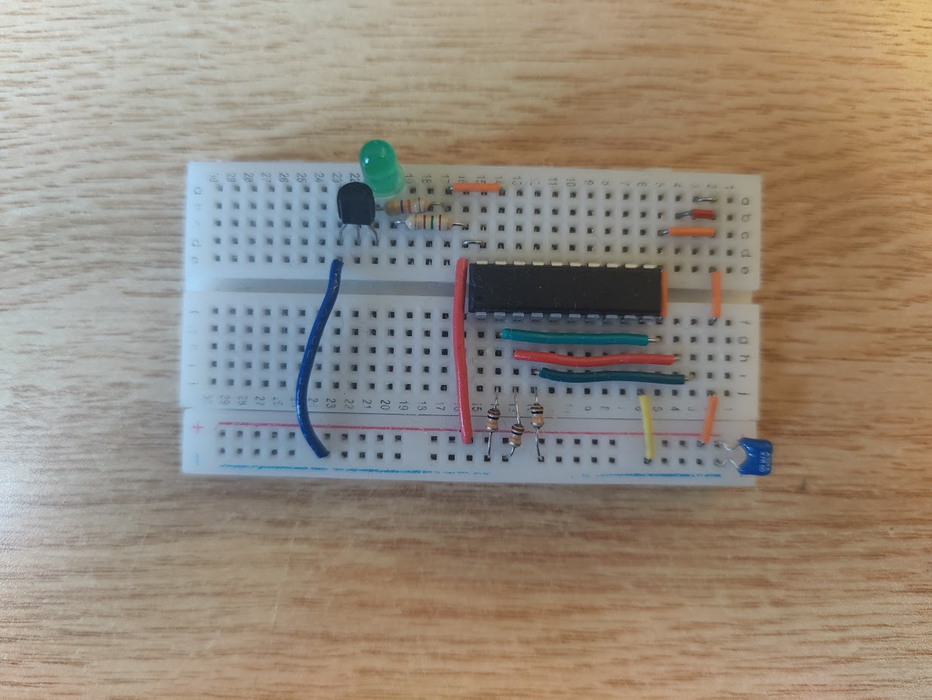
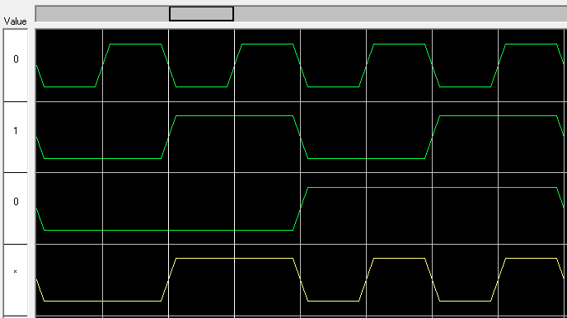
Notes:
Winsim result and breadboard for simulating prime numbers
Wires used instead of switch for breadboard

Slide 4
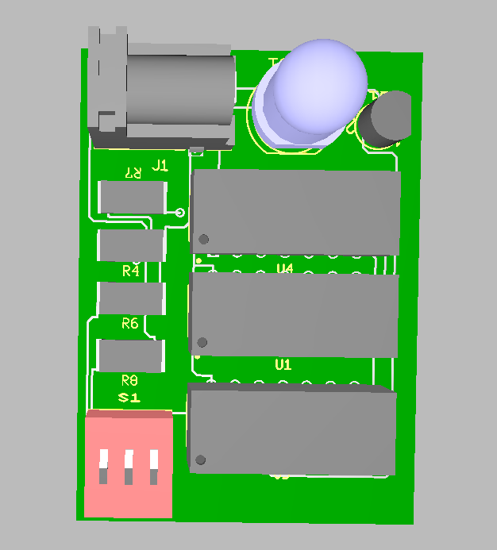
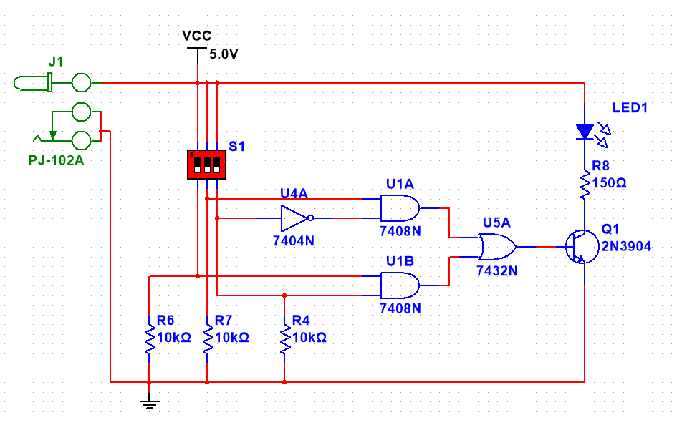
Notes:
Multisim circuit diagram and ultiboard PCB picture

